Slide 1









Weather in Saudi Arabia
(Hokage Heroes)

Slide 2



CONTENTS
01
Introduction
02
EDA
Vision,Problem Statement, Data description
EDA and pre-processing
03
Models
04
Conclusion
models and accuracy
results and future works

Slide 3

Introduction
Vision,Problem Statement, Data description

Slide 4
Vision 2030
Vision 2030 seeks to build a green future.
Where the Saudi Green Initiative aims to protect the environment and deal with climate action and energy transition to achieve a green future.
It seeks to increase vegetation cover and help combat desertification through carefully selected afforestation initiatives throughout the Kingdom, assisted by increasing precipitation levels through Cloud seeding technology.

Slide 5
Problem Statement
The plant needs certain conditions for growth, including air temperature. And the growth of plants varies from one season to another due to the change in weather. In addition to that, the climate in Saudi Arabia is different as a result of its wide area. So what would be the appropriate plant to grow in a specific area and a specific season?
This is what we aim to find a solution for,
what is the appropriate temperature depending on the region and plants ?

Slide 6
Our Data

Slide 7
Data description
01
Saudi Arabia climate integrated surface data with the below data observations :
Wind
Sky condition
Visibility
Air temperature
Sea level pressure

Slide 8
Data description
02
A set of data that contains information about plants and the climate suitable for them
Crop name
Min/Max/Avg temperature

Slide 9
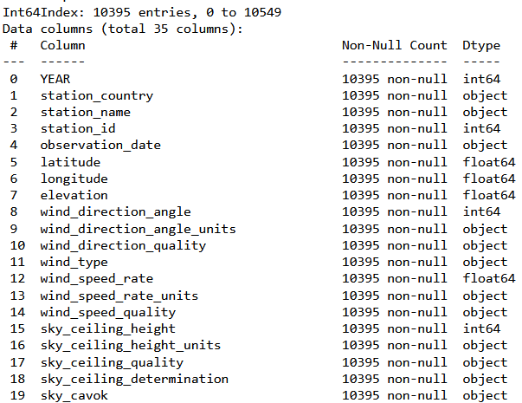
Dataset Info

Slide 10
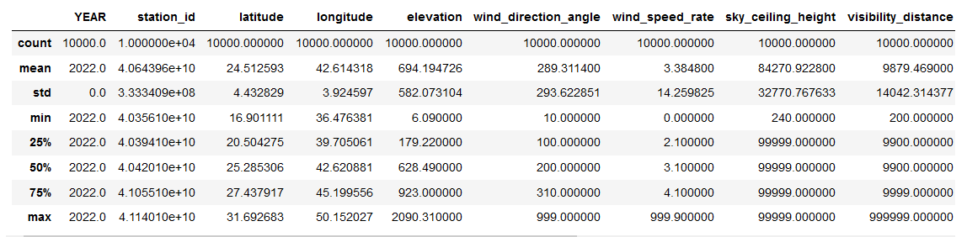
Dataset Num Description

Slide 11
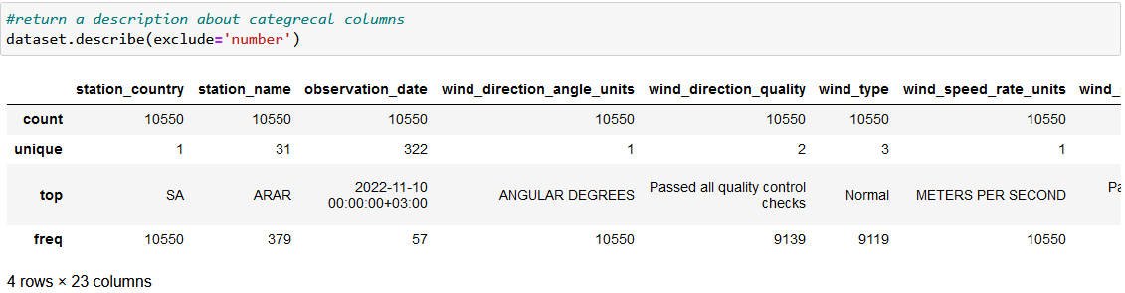
Dataset Object Description

Slide 12
Pre-processing

Slide 13
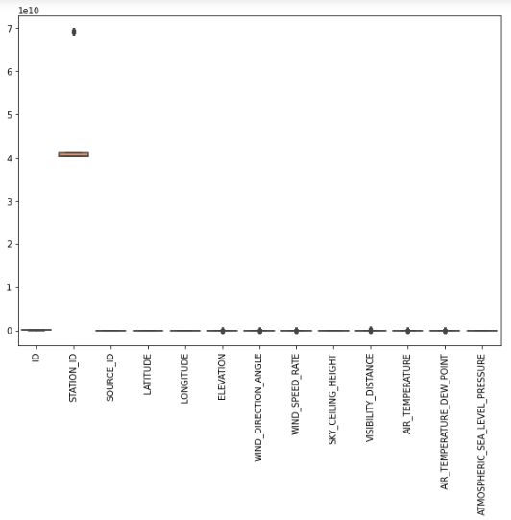
Outlier
Outlier in dataset

Slide 14
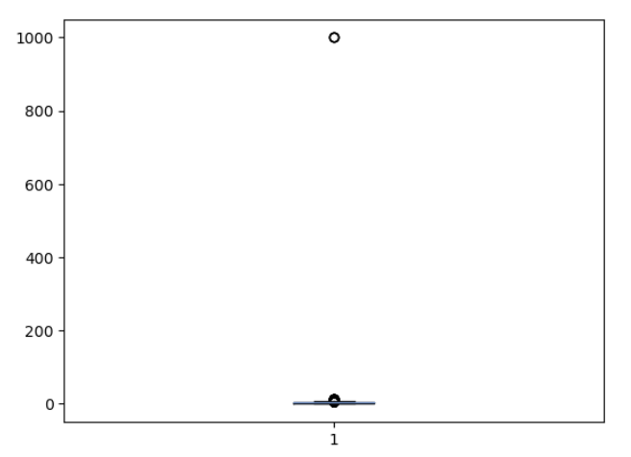
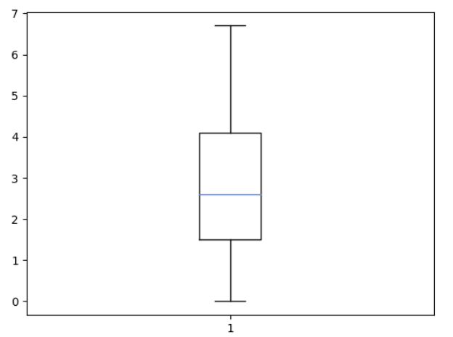
Outlier
Wind_speed_rate > 100

Slide 15
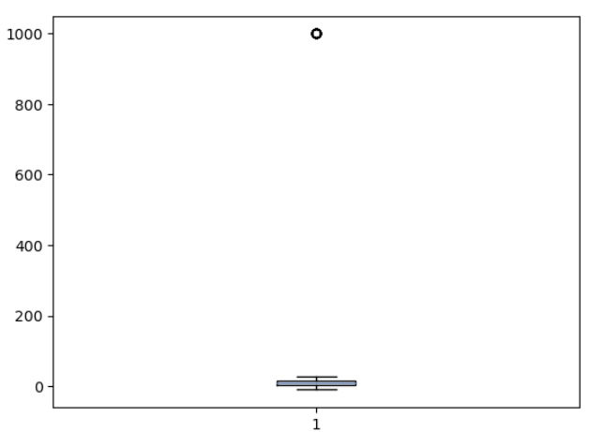
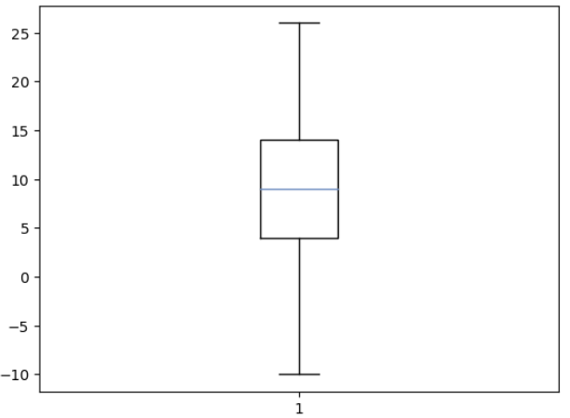
Outlier
Air_temperature_dew_point > 50

Slide 16
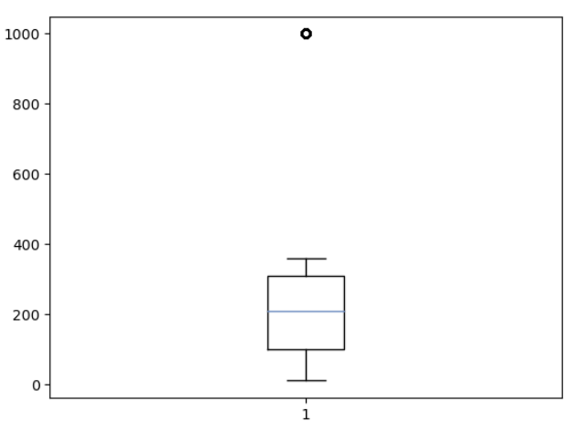


Outlier
Wind_direction_angle

Slide 17
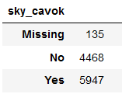

Missing/duplicate Value

Slide 18
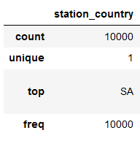
Missing/duplicate Value

Slide 19
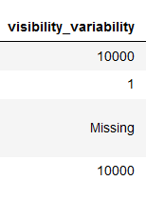
Missing/duplicate Value

Slide 20
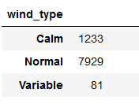
Missing/duplicate Value

Slide 21
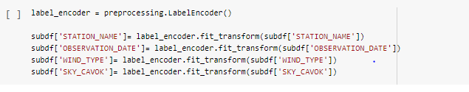
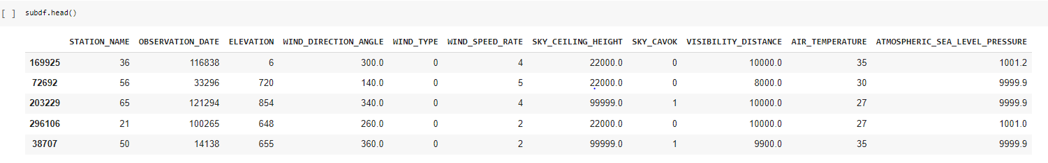
Feature Engineering-Encoding
In features with binary values do the transform to numbers 1 = yes else number = 0 as (SKY_CAVOK) there are two value yes, No.
For a categorical features will perform a label encoding.

Slide 22
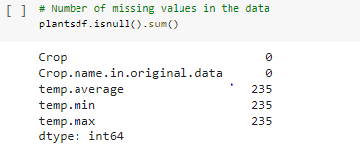
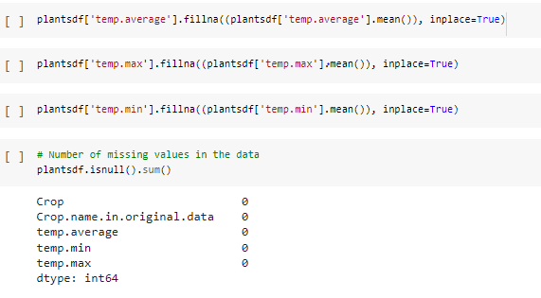
Missing Value
Filling the Null value with the mean

Slide 23
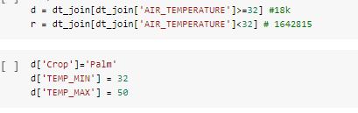
Missing Value
Filling the [Crop] with (Palm) when the [AIR_TEMPERATURE] more than 32
Filling the remain Null value with mode

Slide 24

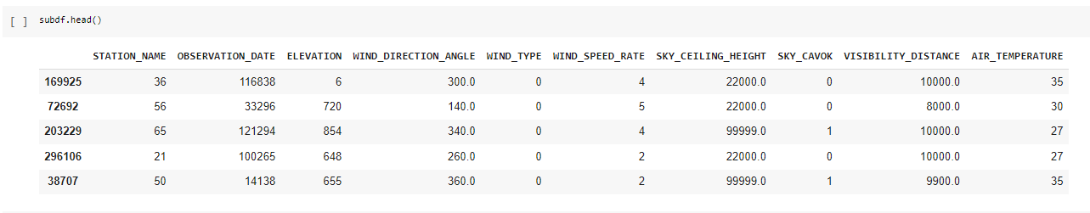
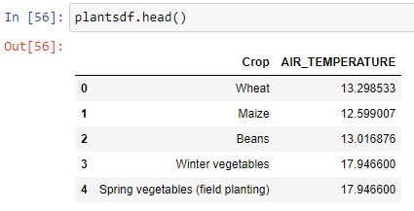
Join two dataset

Slide 25
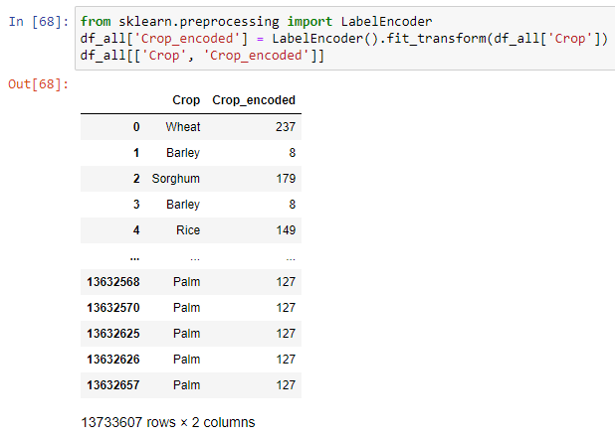

Feature Engineering-Encoding
Perform Label Encoder for [Crop] column there is 250 unique value.

Slide 26
Visualization

Slide 27
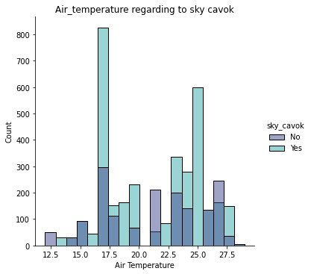
Displot
This graph shows the distribution of air temperature relationship to the sky cavok with its ratio on each column to the other as you see.
The lowest value of temperature is 28 degrees, while The top 3 highest values are in 17, 25, and 23 degrees approximately.

Slide 28
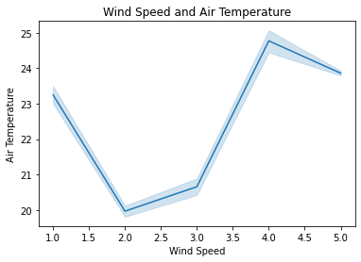
Lineplot
On this chart we conclude:
The highest Average of air_temperature happen at 24.77, when wind_speed value is equal to 4.
The lowest Average of air_temperature at 19.97, when wind_speed value is equal to 2.
Across all 5 wind_speed_rate, Average of air_temperature ranged from 19.97 to 24.77.

Slide 29
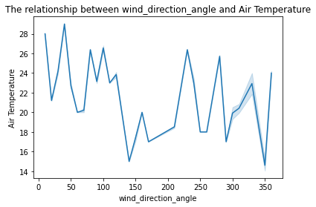
Lineplot
On this chart we conclude:
At 29 air_temperature, 40 wind_direction_angle had the highest Average of air_temperature and was 98.54% higher than 350, which had the lowest Average of air_temperature at 14.61.
40 had the highest Average of air_temperature at 29, followed by 10 and 100.
350 had the lowest Average of air_temperature at 14.61.
Across all 28 wind_direction_angle, Average of air_temperature ranged from 14.61 to 29.

Slide 30
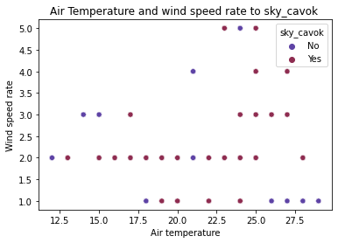
Scatterplot
This scatter plot shows the air temperature and wind speed rate, And their relationship to the sky cavok, the values are distributed almost randomly, but most of the clear visibility is concentrated on wind speed rate at 2, and most of the Non-clear visibility values are in the wind speed rate at 1.

Slide 31
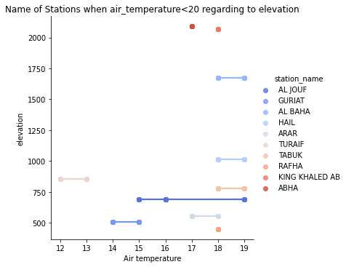
Lmplot
This graph shows the name of Stations when air_temperature < 20 regarding elevation,
As we look from down to the top,
RAFHA has a lower than 500 elevation considered as lowest and its air temp equal to 18
GURIAT has a little bit above 500 elevation and its air temp between 14 and 15
ARAR has a little bit above 500 elevation and its air temp between 17 and 18
ALJOUF has an elevation close to 750 and its air temp between 15 and 19
TABUK has a little bit above 750 elevation and its air temp between 18 and 19
TURAIF has above 800 elevation and its air temp between 12 and 13
HAIL has a little bit above 1000 elevation and its air temp between 18 and 19
ALBAHA has above 1600 elevation and its air temp between 18 and 19
KING KHALED AB has above 2060 elevation and its air temp equal to 18
ABHA has above 2085 elevation and its air temp equal to 17

Slide 32
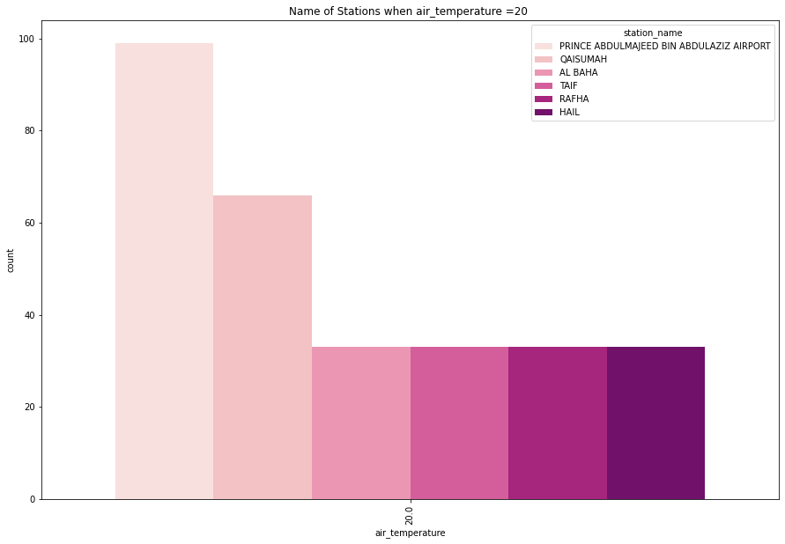
Countplot
We can insight here the Name of Stations when air_temperature =20, which is Prince Abdulmajeed bin Abdulaziz Airport, Qaisumah, AlBaha, Taif, Rafha, and Hail.
We can insight from the names of the stations knowing the appropriate plants to plant in each region, or for airports, weather conditions, and flight times.

Slide 33
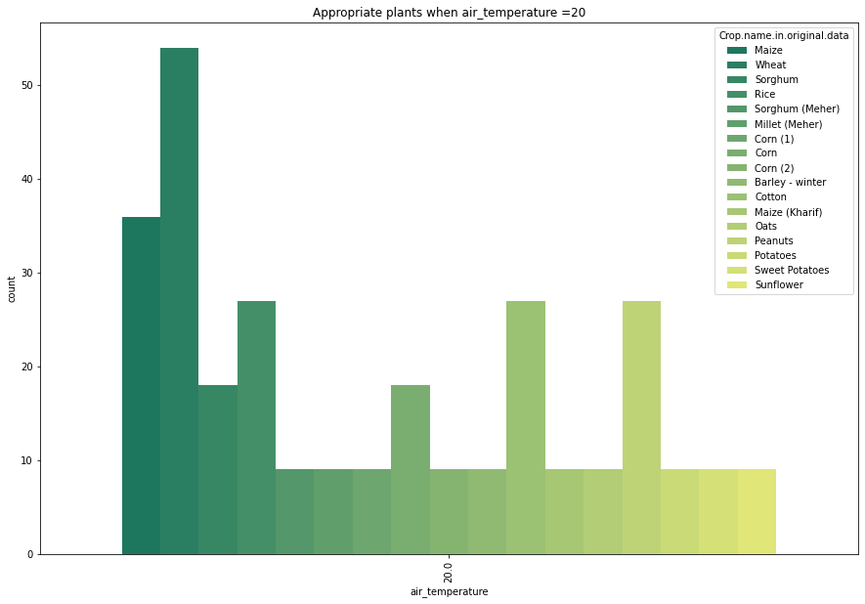
Countplot
What this chart interpret is the Name of appropriate plants when air_temperature =20, which are Maize, Wheat, Sorghum, Rice, Millet, Corn, Barley, Cotton, Oats, Peanuts, Potatoes, and Sunflower.
We can insight from the names of the plants knowing which plants are suitable for each temperature and which plant is the most popular and desirable.

Slide 34
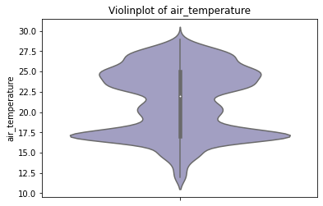
Violinplot
This violin plot shows the temperature that the maximum temperature is above 27.5 and the minimum temperature is below 12,5 and the median temperature is 22.5 approximately.

Slide 35
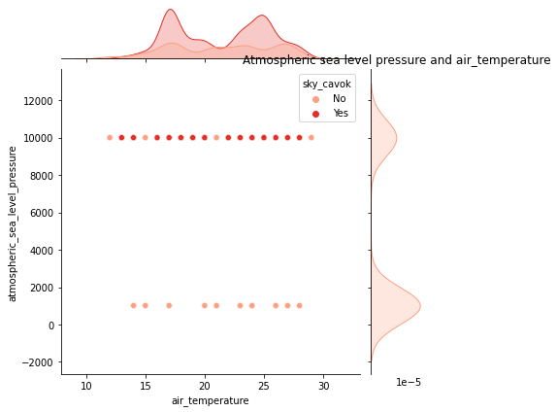
Jointplot
On this joint plot,
The distribution on the top shows the distribution of air_temperature and the distribution on the right shows the distribution of atmospheric_sea_level_pressure. And the scatter plot represents the usual relationship of air_temperature Vs atmospheric_sea_level_pressure.
As you can see, when a low-pressure moves into an area, it usually leads to cloudiness, wind, and precipitation which makes the sky visibility not clear. High pressure usually leads to fair, calm weather. Therefore, The sky visibility will be more clear Except for some areas based on elevation or other factors.

Slide 36
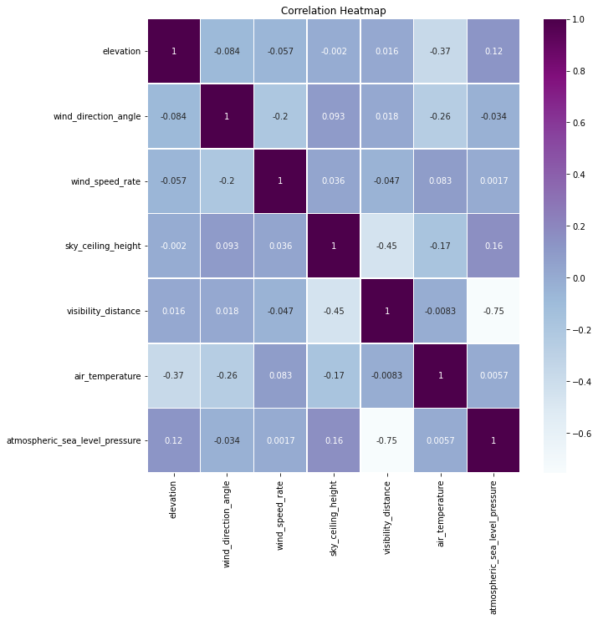
Correlation
From our heatmap, we can infer:
we could get that there are no many variables having strong positive correlation.
Feature 'visibility_distance' has a strong negative correlation with features 'atmospheric_sea_level_pressure' and 'sky_ceiling_height' with values -0.75 and -0.45 respectively

Slide 37
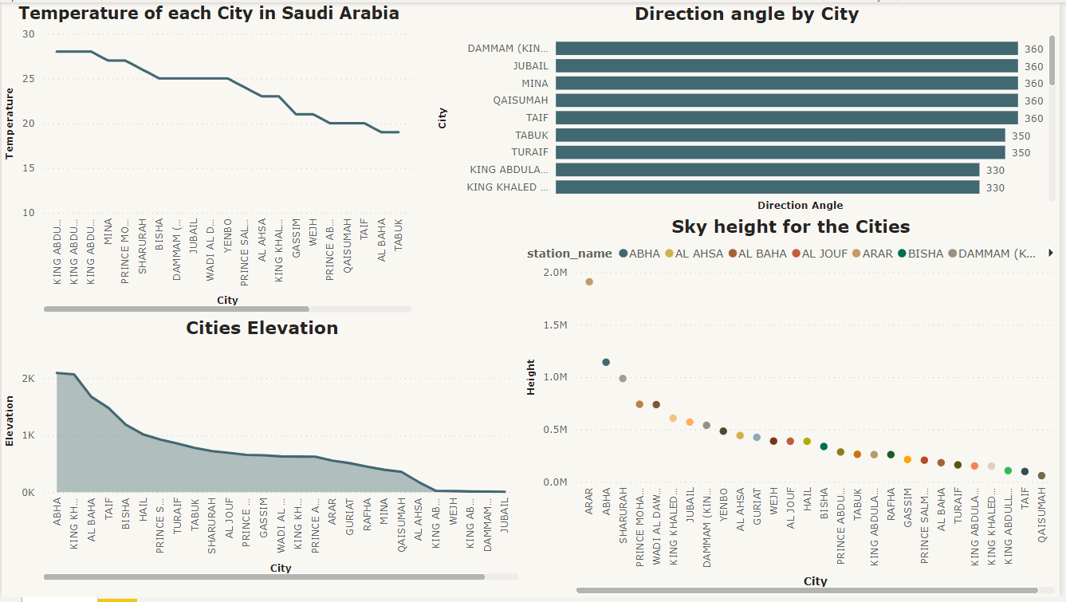
Dashboard

Slide 38
Models

Slide 39

Introduction
Kingdom Saudi Arabia has a big area with different weather, some plants are suitable for the eastern province, and others can plant in the north

Slide 40
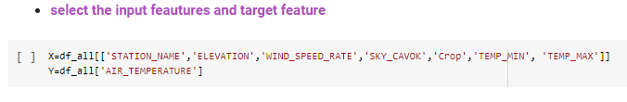

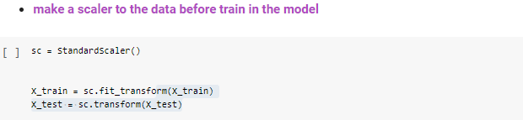
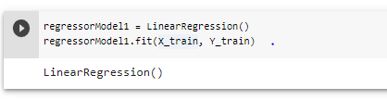
1- Regression Model

Slide 41
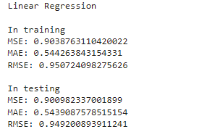

1- Regression Model

Slide 42
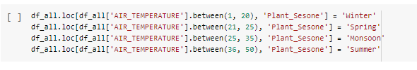
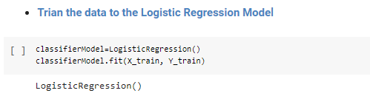
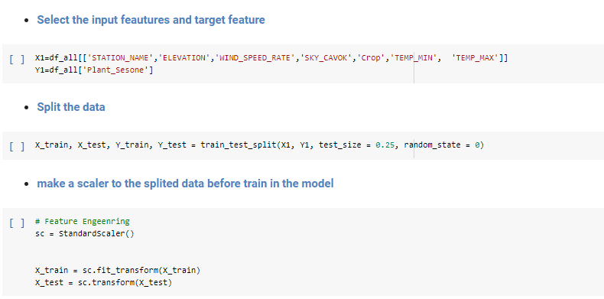
2- Classification Model
Target Value

Slide 43
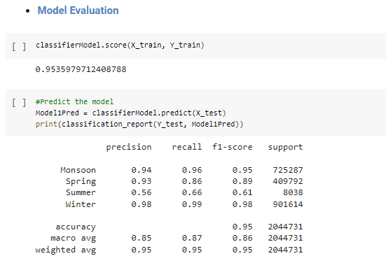
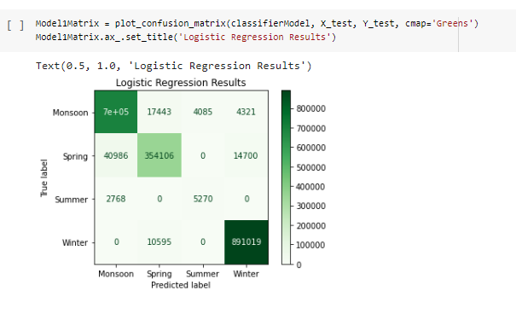
2- Classification Model
2- Classification Model

Slide 44

Results
Since we cannot compare two different kinds of models, therefore, we considered a linear regression model the best model

Slide 45
Future work
Trying another regression model, like the random forest, decision tree, or polynomial regression
Built an advanced model such as a recommendation system
Using a temp_min or temp_max a target value instead of temp_average

Slide 46
Thanks!
Any Questions?
Shouq Alharbi
Razan Alajlan
Nada Oteif
Hayam Alrashed
Sarah Alrashidi

